Slide 1
Lecture 18: Introduction to MRI Principle
Dr. Guohua Cao （曹国华） caogh@shanghaitech.edu.cn
School of Biomedical Engineering
ShanghaiTech University
4/9/2023

Slide 2

Nuclear magnetic resonance exploits a property of the nucleus called spin.
Spin is related to the angular momentum of the nucleus and each subatomic particle.
Spin is a quantum mechanical property, which means it has discrete quantized states.
Nuclear Spin, I, is the total angular momentum of the nucleus.
The Nuclear Spin ranges from 0 to 7 in half integers.
The total number of different spin states is 2I+1

Slide 3
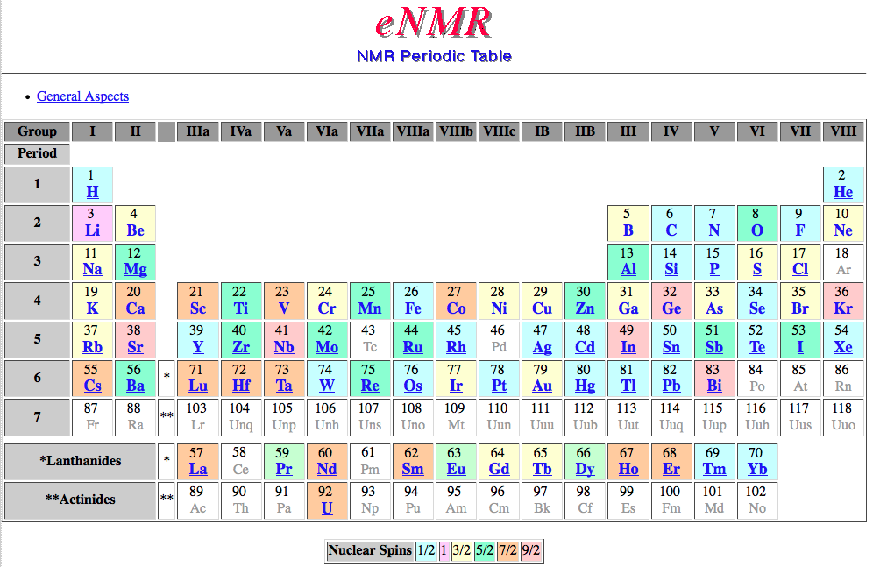
A nucleus has spin if it has either an odd number of protons or neutrons.
http://www.bruker-nmr.de/guide/eNMR/chem/NMRnuclei.html
Notes:
Nuclear (like ⁴He, ¹²C, and ³²S) with even numbers of both protons and neutrons have I = 0 and possess no net angular momentum

Slide 4
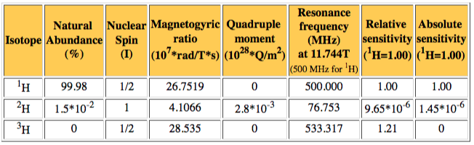
An example from the eNMR Periodic Table showing the isotopes of Hydrogen.
Notes:
Angular momentum changes in whole units.

Slide 5
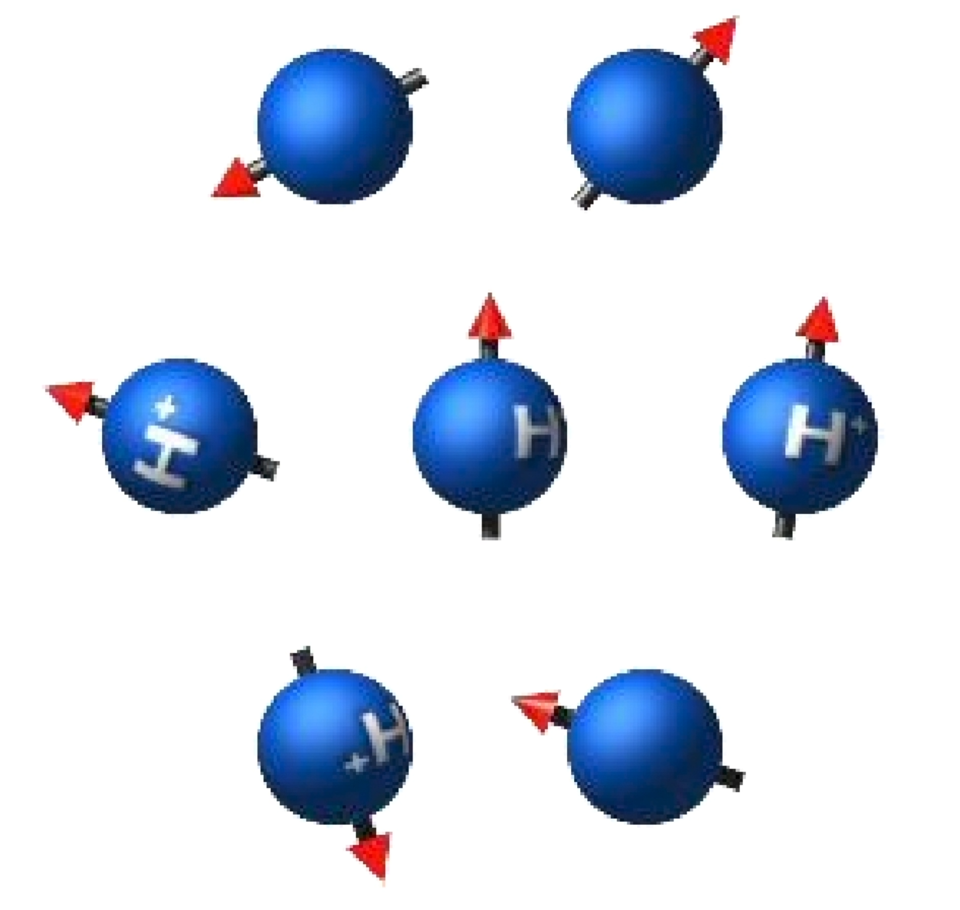
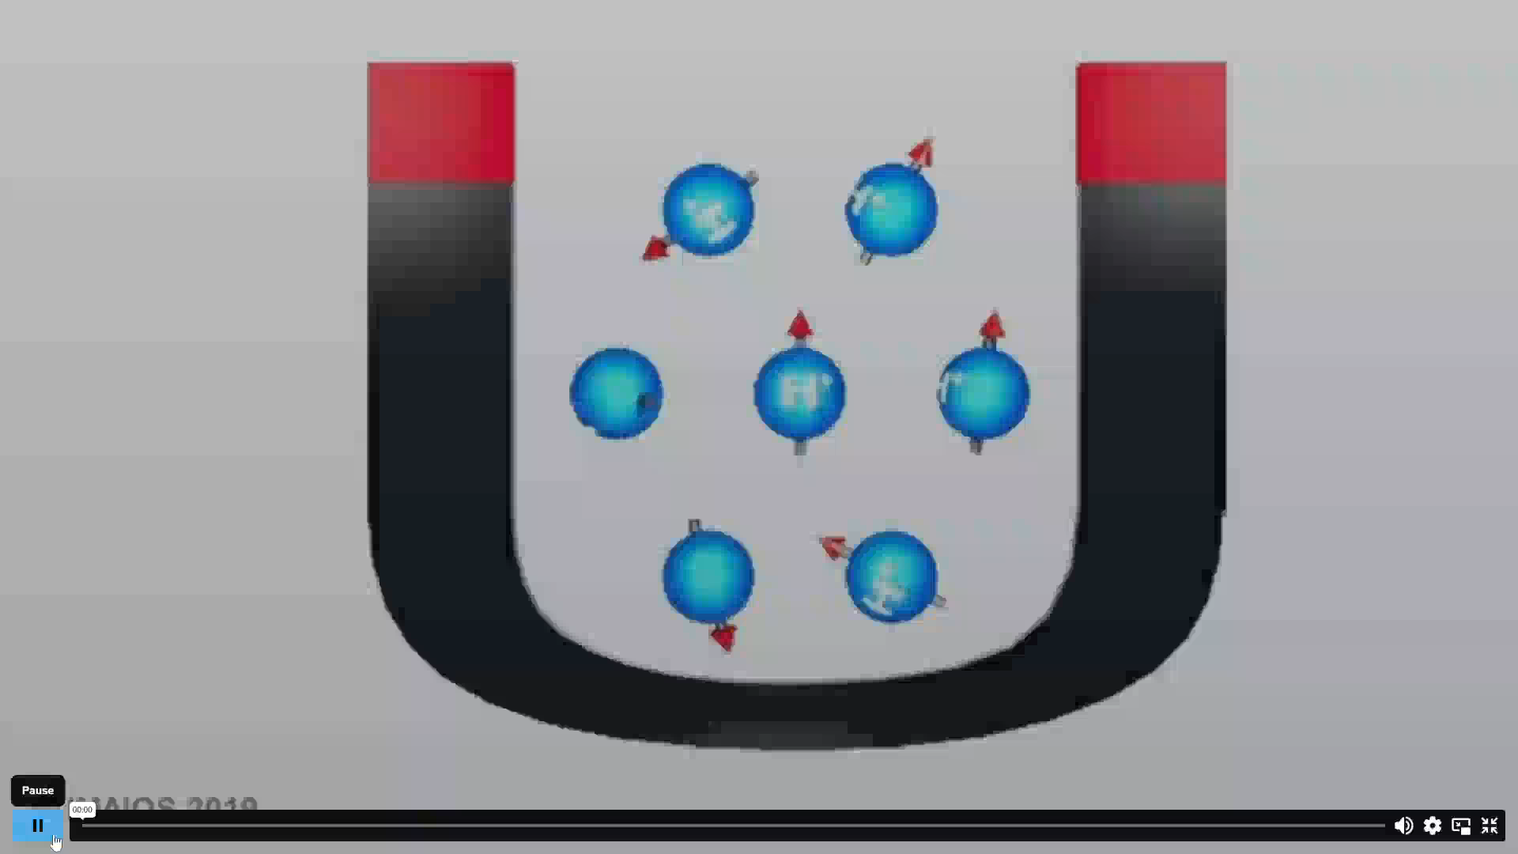
total magnetic spin in a voxel
w/o external magnetic field
w. external magnetic field, B₀
null net magnetization
Some of the spins align with the field (parallel) and some align against the field (anti-parallel).

Slide 6
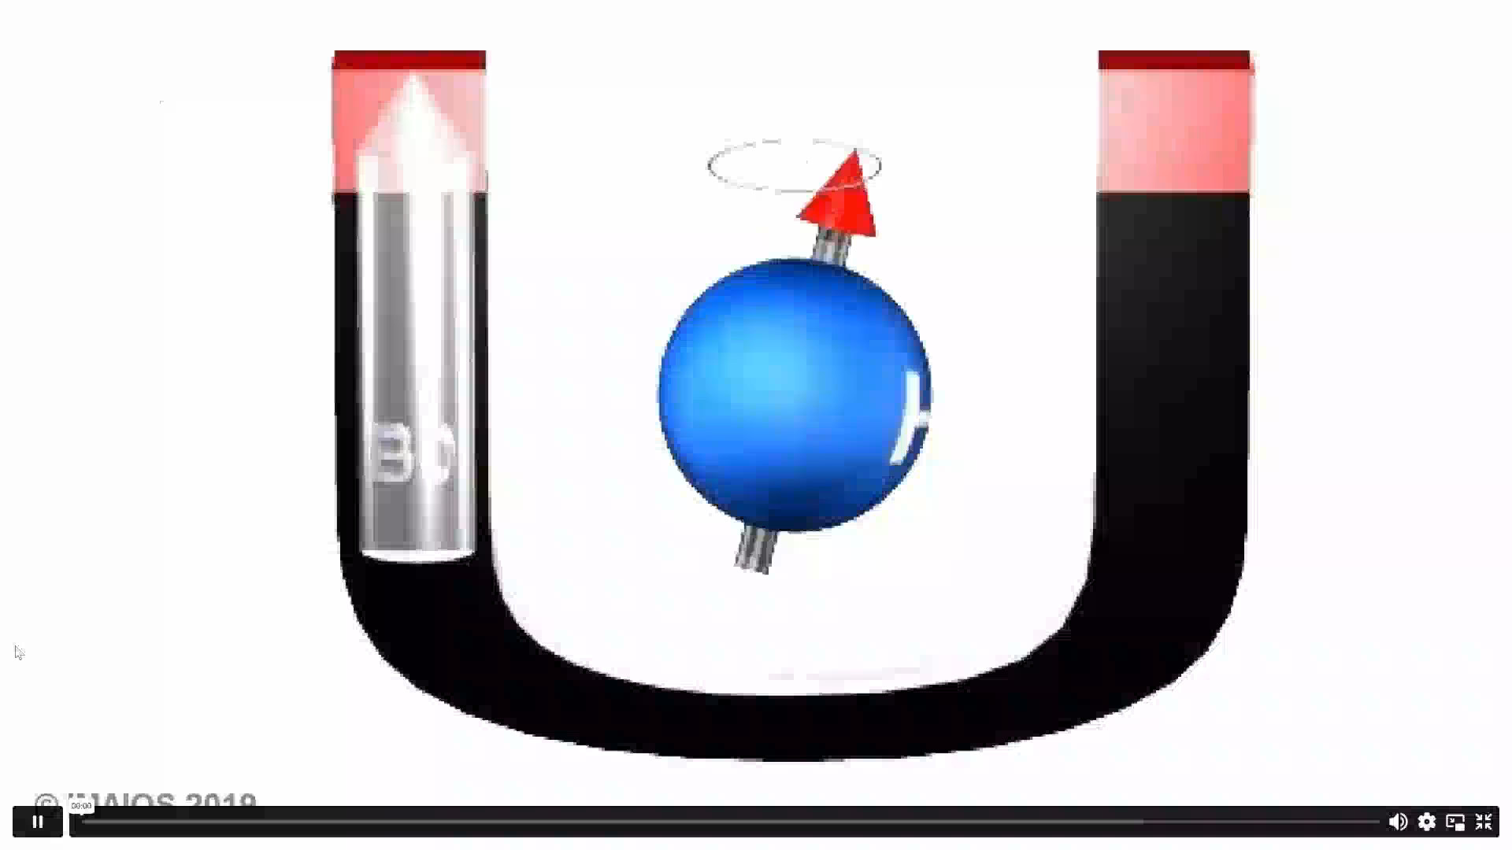
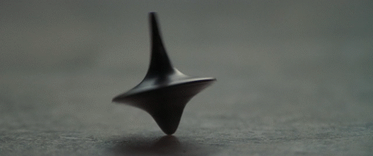
Precession：进动
陀螺仪的进动
Precession of Gyroscope
Spin Precession
wobble (or precess) about the axis

Slide 7
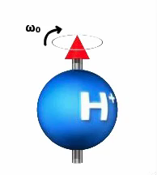
Precession Frequency i.e. Larmor Frequency
Magnetic moments precess in a magnetic field.
Larmor frequency: frequency of precession and resonance, usually in the radiofrequency (RF) range
ω₀ = γ B₀

Slide 8
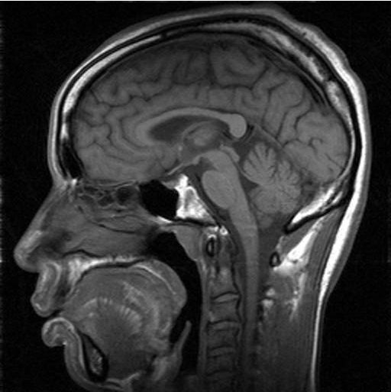
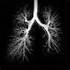
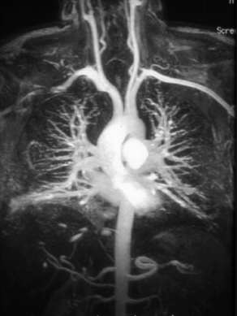
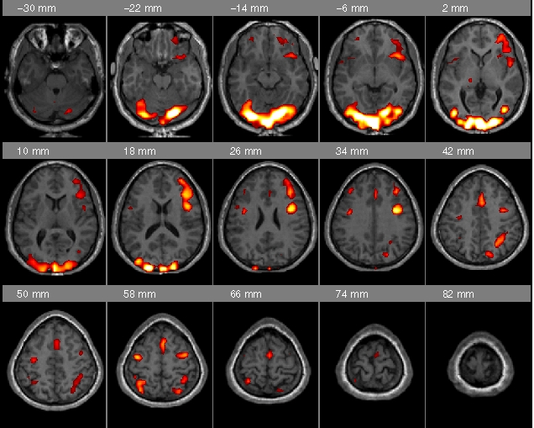
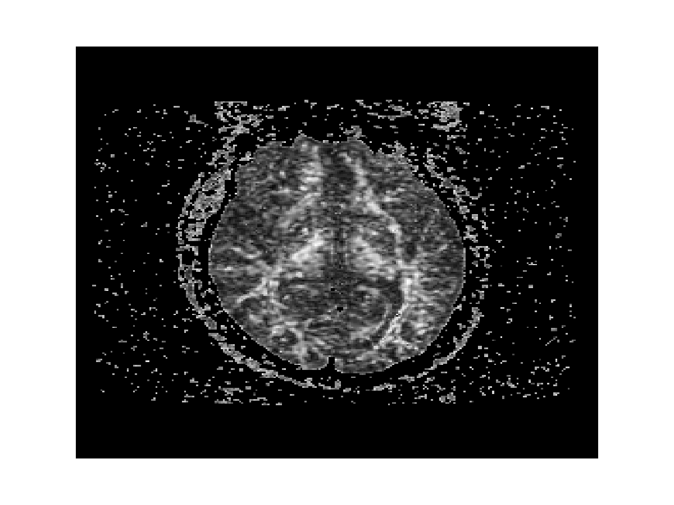
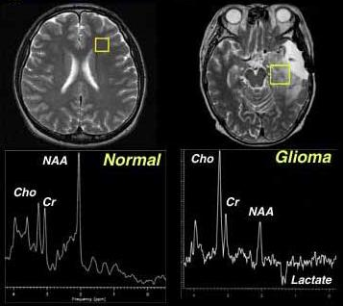
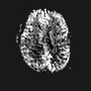
Magnetic Resonance Imaging (MRI) measures the precession of spins in a magnetic field to produce “images” that yield structural, physiological, and/or chemical information.
Structural
Structural –HE₃
Flow
Functional
Perfusion
Diffusion
Spectroscopy
Notes:
Questions that will be answered through out this course?
What is a “spin”?
Why did you use the word “spin” instead of “proton” or “water”?

Slide 9
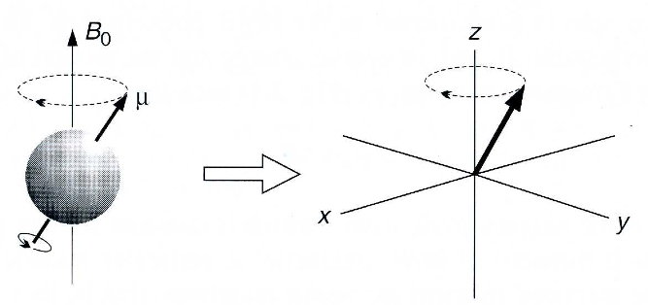
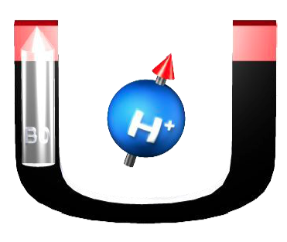
Why are the spins not EXACTLY aligned with the magnetic field?
http://www.chem.umn.edu/groups/harned/classes/8361/lectures/NMR.pdf
Notes:
Quantum Mechanis:
http://www.quantumdiaries.org/2011/09/17/angular-momentum-in-quantum-mechanics/

Slide 10
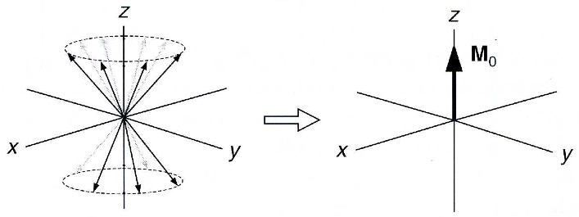
Heisenberg Uncertainty Principle states that if we know one component of the angular momentum exactly then we know nothing about the other two components.
http://www.chem.umn.edu/groups/harned/classes/8361/lectures/NMR.pdf
This subtle but very important point is often not explained. The magnetic moment of a spin is drawn as a cone or at at an angle to the magnetic field.
For more information see http://www.quantumdiaries.org/2011/09/17/angular-momentum-in-quantum-mechanics/
Notes:
http://www.quantumdiaries.org/2011/09/17/angular-momentum-in-quantum-mechanics/

Slide 11
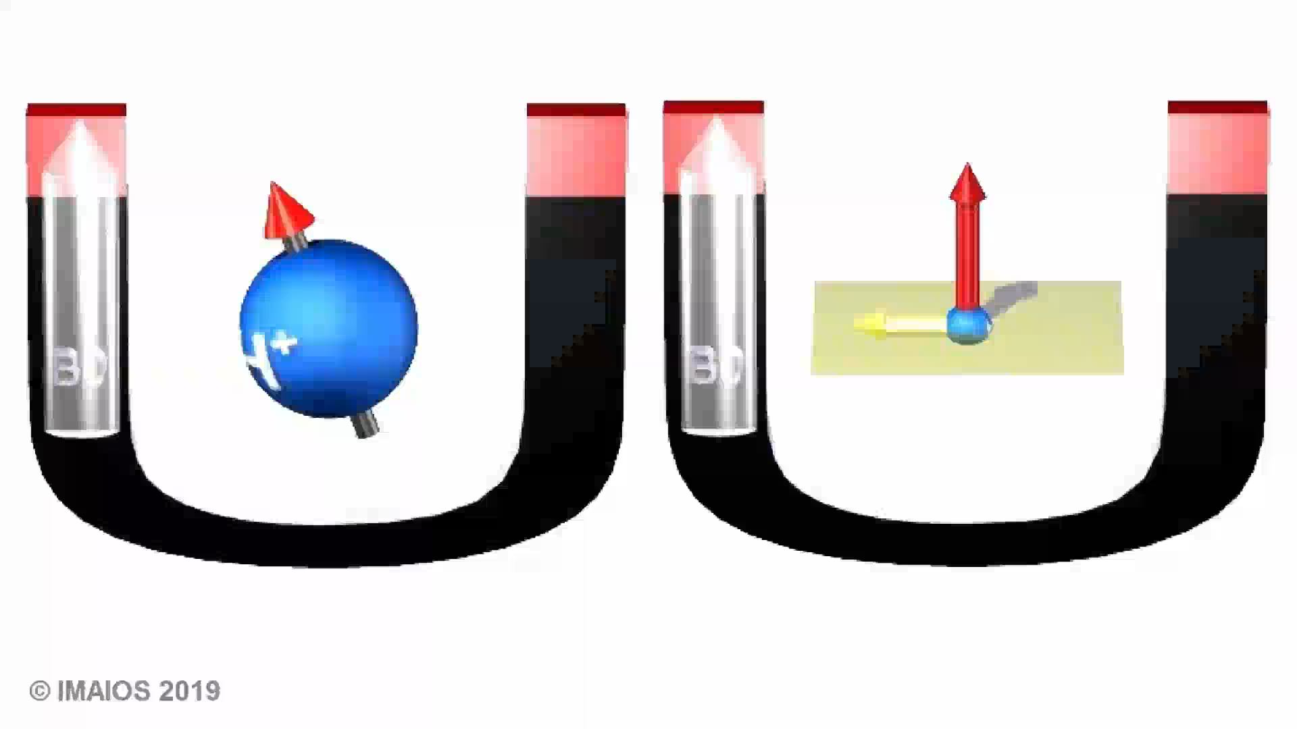
We can decompose the net magnetic moment into its three components: Mx, My, and Mz
The magnetic vector of spinning protons can be broken down into two orthogonal components: a longitudinal or Z component, and a transverse component, lying on the XY plane.
Precession corresponds to rotation of the transverse component about the longitudinal axis.

Slide 12


Net magnetization in Z axis and XY plane
More spins aligned with the field than spins aligned against the field
Spins do not rotate in phase, thus null transverse macroscopic magnetization.

Slide 13
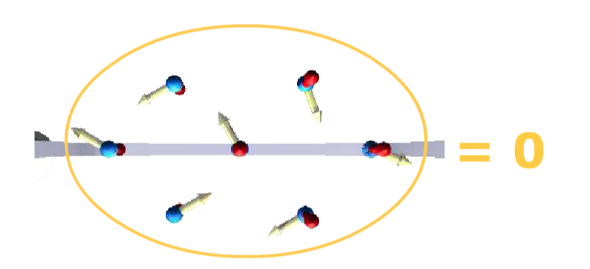
There is no Net Magnetic Moment along the X and Y direction because “classically” the individual magnetic moments have random orientations.

Slide 14
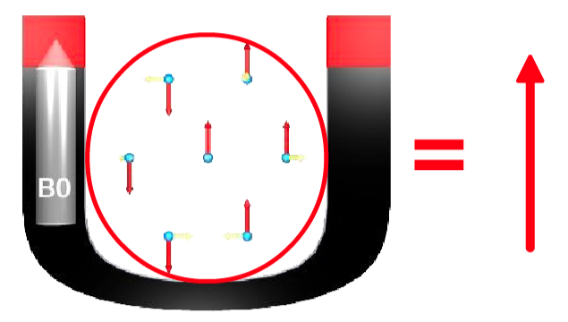
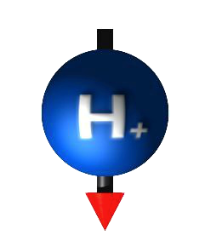
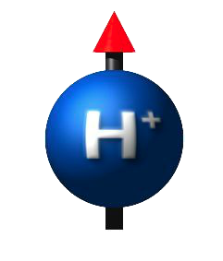
A Net Magnetic Moment along the Z direction is created by the external magnetic field according to the Boltzmann Distribution.
Magnetic moments align relative to a magnetic field in discrete number of energy states.

Slide 15

Boltzmann Distribution
B₀
anti-parallel - high energy state
parallel - low energy state
N_{up} / N_{down} = Proportion of parallel / antiparallel spins
γ = Gyromagnetic ratio
h = Planck's constant / 2π
k = Boltzmann's constants
T = Temperature (in Kelvins)
B = Intensity of static magnetic field (Teslas)

Slide 16
Nuclear Magnetic Resonance (NMR)
Resonance is exchange of energy between two systems at a specific frequency.
Magnetic resonance corresponds to the energetic interaction between spins and electromagnetic radiofrequency (RF).
Only protons that spin with the same frequency as the electromagnetic RF pulse will respond to that RF pulse.
Excitation: There is a modification of spin equilibrium and absorption of electromagnetic energy by atomic nuclei, which is called excitation.
Relaxation: When the system returns from this state of imbalance to equilibrium (relaxation), there is an emission of electromagnetic energy.

Slide 17
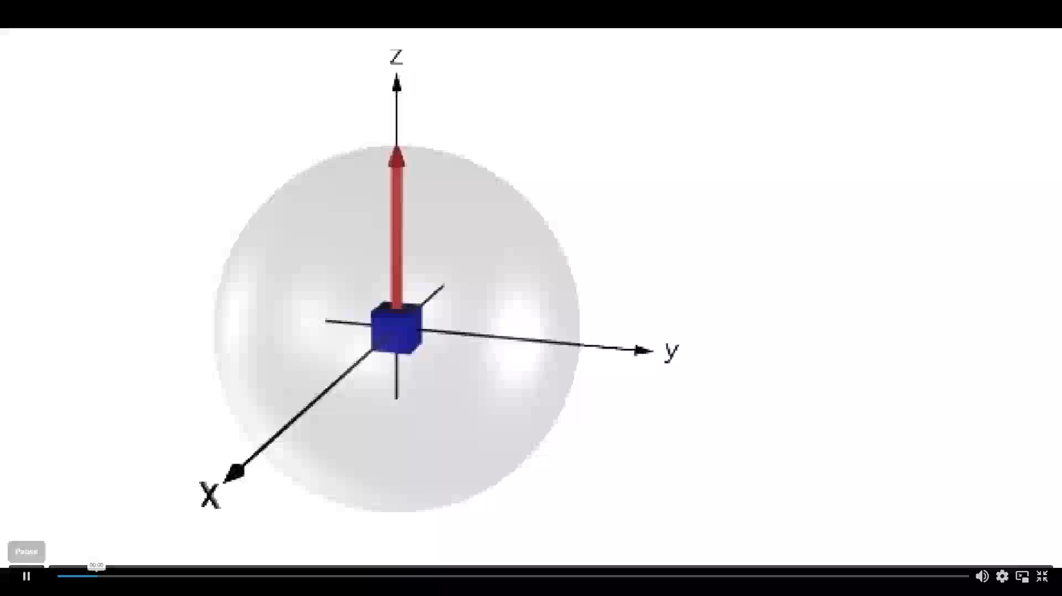
Excitation
During excitation, longitudinal magnetization decreases and a transverse magnetization appears (except for a 180° flip angle).
Longitudinal magnetization is due to a difference in the number of spins in parallel and anti-parallel state. Transverse magnetization is due to spins getting into phase coherence.
The flip angle depends on the strength and duration of the electromagnetic RF pulse.

Slide 18

90°flip angle
Notes:
There is no longitudinal magnetization (equal proportion of parallel and anti-parallel spins)
A transverse magnetization exists (all spins are in phase: complete phase coherence)

Slide 19
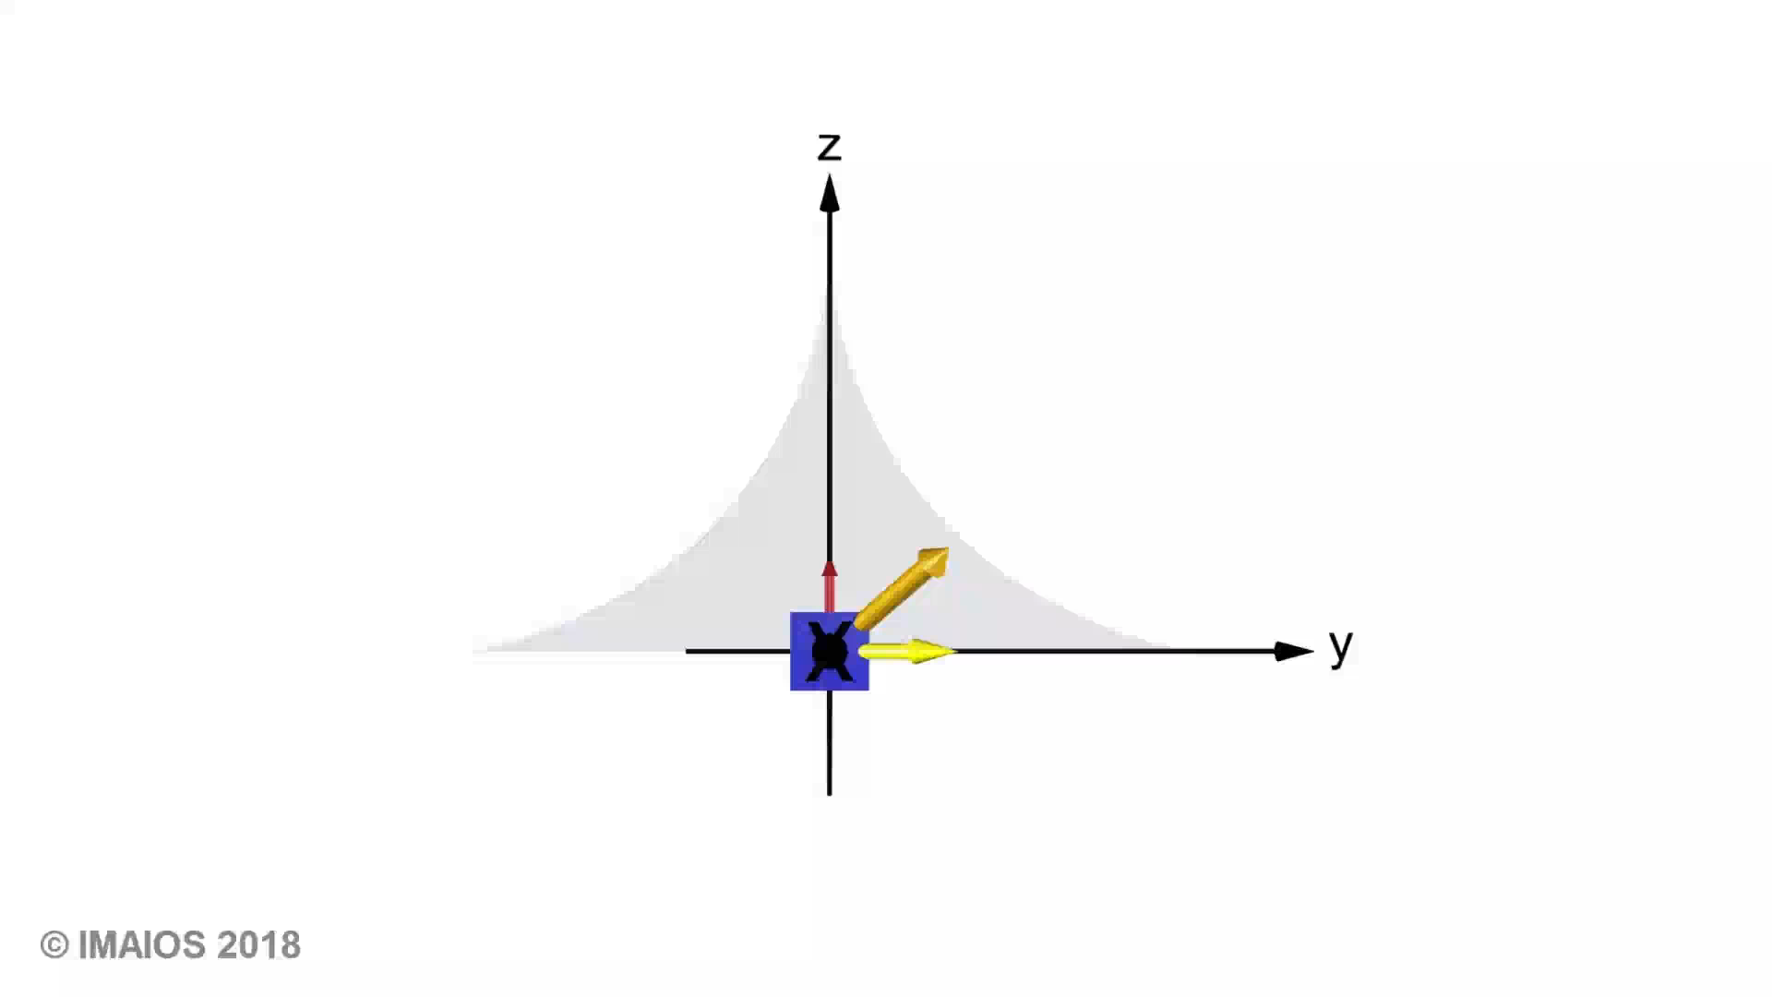
Relaxation
Return to equilibrium of net magnetization is called Relaxation. During relaxation, electromagnetic energy is retransmitted: this RF emission is called the NMR signal.
Relaxation combines 2 different mechanisms:
Longitudinal relaxation corresponds to longitudinal magnetization recovery
Transverse relaxation corresponds to transverse magnetization decay
Notes:
Return to equilibrium of net magnetization is called Relaxation. During relaxation, electromagnetic energy is retransmitted: this RF emission is called the NMR signal. Relaxation combines 2 different mechanisms:
Longitudinal relaxation corresponds to longitudinal magnetization recovery
Transverse relaxation corresponds to transverse magnetization decay

Slide 20

T1 Relaxation (Longitudinal relaxation)
After time T1, longitudinal magnetization has returned to 63 % of its final value.
Notes:
Longitudinal relaxation is due to energy exchange between the spins and surrounding lattice (spin-lattice relaxation), re-establishing thermal equilibrium. As spins go from a high energy state back to a low energy state, RF energy is released back into the surrounding lattice.
The recovery of longitudinal magnetization follows an exponential curve. The recovery rate is characterized by the tissue-specific time constant T1. After time T1, longitudinal magnetization has returned to 63 % of its final value. With a 1.5 T field strength, T1 values are about 200 to 3000 ms. T1 values are longer at higher field strengths.

Slide 21
T1 Relaxation
T1 Relaxation exchanges energy with the environment
T₁

Slide 22

T2 Relaxation (Transverse relaxation)
After time T2, transverse magnetization has lost 63 % of its original value.
Notes:
Transverse relaxation results from spins getting out of phase.
As spins move together, their magnetic fields interact (spin-spin interaction), slightly modifying their precession rate. These interactions are temporary and random.
Thus, spin-spin relaxation causes a cumulative loss in phase resulting in transverse magnetization decay. Transverse magnetization decay is described by an exponential curve, characterized by the time constant T2. After time T2, transverse magnetization has lost 63 % of its original value.

Slide 23
T2 Relaxation decays exponential and determines how long one is able to detect the spins in the transverse plane.
T2 Relaxation spins exchanges energy with each other. (Loss of coherence)
T₂

Slide 24

Excitation & Relaxation Combined
Notes:
MRI signal is generated during the relaxation.

Slide 25
Excited spins want to return to thermal equilibrium – aligned along the main magnetic field.
T1 relaxation describes how fast the spins align with the magnetic field.
T2 relaxation describes how fast spins lose spin coherence.

Slide 26
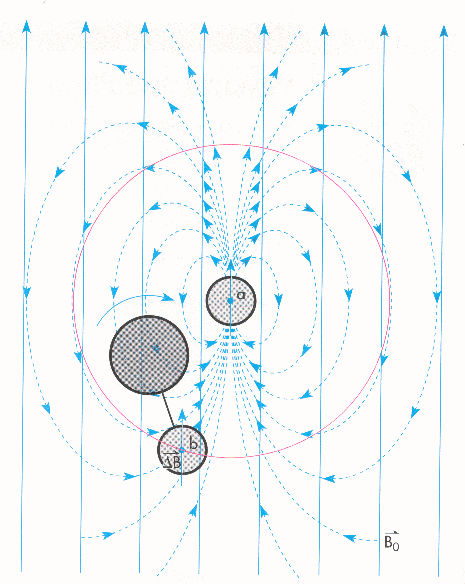
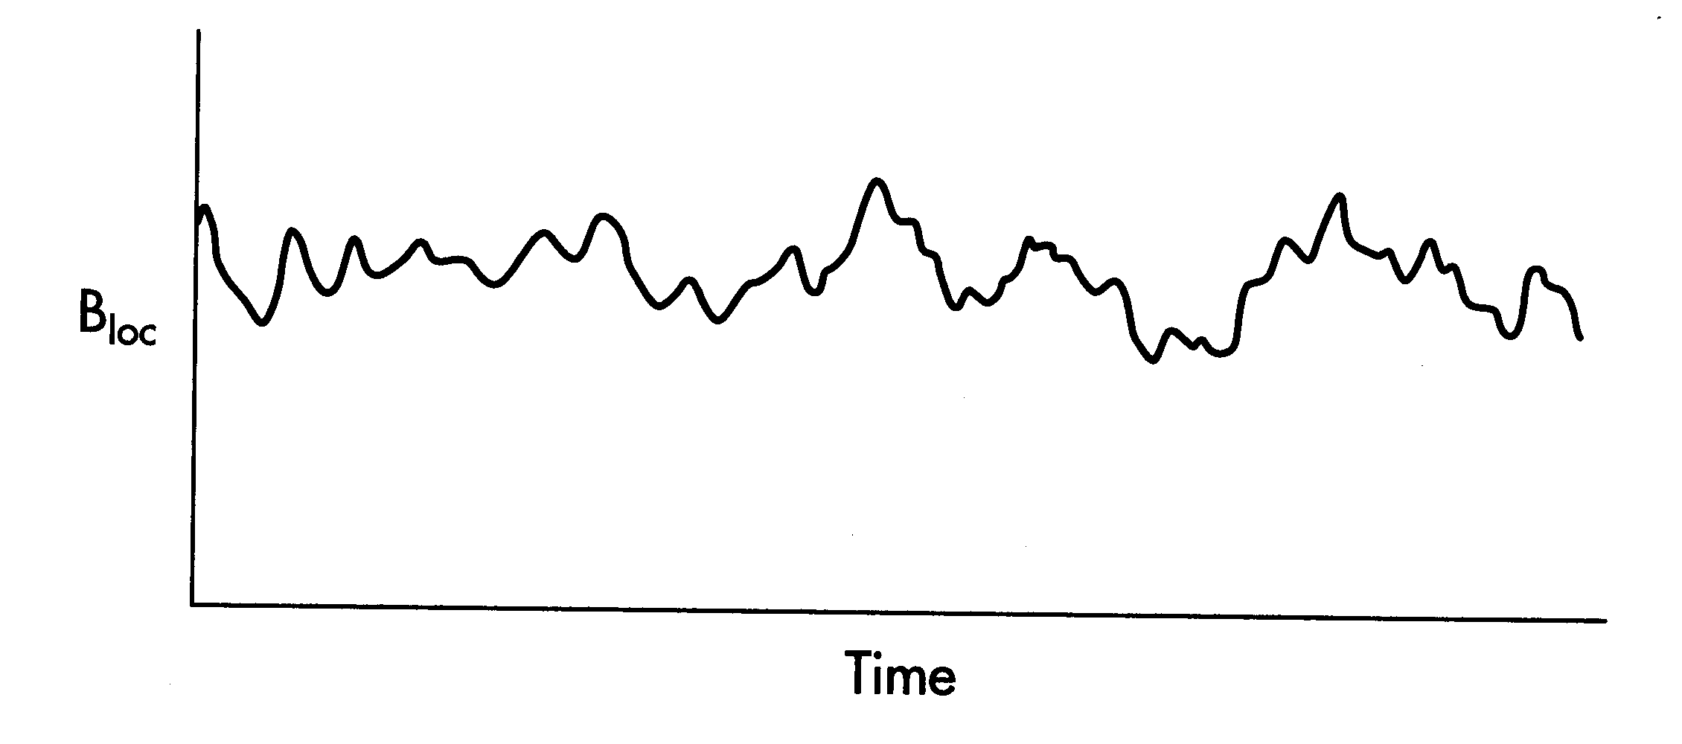
T2 Relaxation is a fundamental property of the material.
Random fluctuations in local magnetic field seen by the nucleus result in a random change to the precession frequency of the spins

Slide 27
T2* Relaxation
Is not an intrinsic property of the tissue/substance but is relaxation due to the inhomogeneity of the magnetic field
Homogeneity is the uniformity of the magnetic field over a given volume (sphere)
Measured in parts per million (ppm)
Typical magnet ±2.5 ppm over 40 cm
Temporal and temperature stability
Notes:
http://eu.amershamhealth.com/medcyclopaedia/Volume%20I/PARTS%20PER%20MILLION%20%20PPM%20.asp
Parts per million (PPM),
term used in MR imaging to define the quality of the magnetic field homogeneity or the chemical shift of a substance investigated. A field inhomogeneity of 10 ppm in a field of 1.5 Tesla thus means maximum field strength variations of 1.5 10 5 Tesla or 0.15 gauss. Since magnetic field and resonant frequency are proportional (Larmor equation), an inhomogeneity of 1 ppm also translates into Larmor frequency variation of 63.9 Hz at 63.9 MHz.

Slide 28
Relationship between T2 and T2*
T2 Relaxation
T2’ is the relaxation constant due to magnetic field inhomogeneity alone
T2* Relaxation

Slide 29
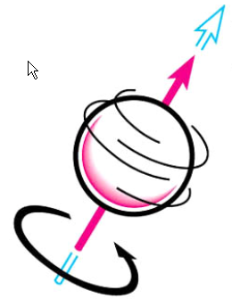
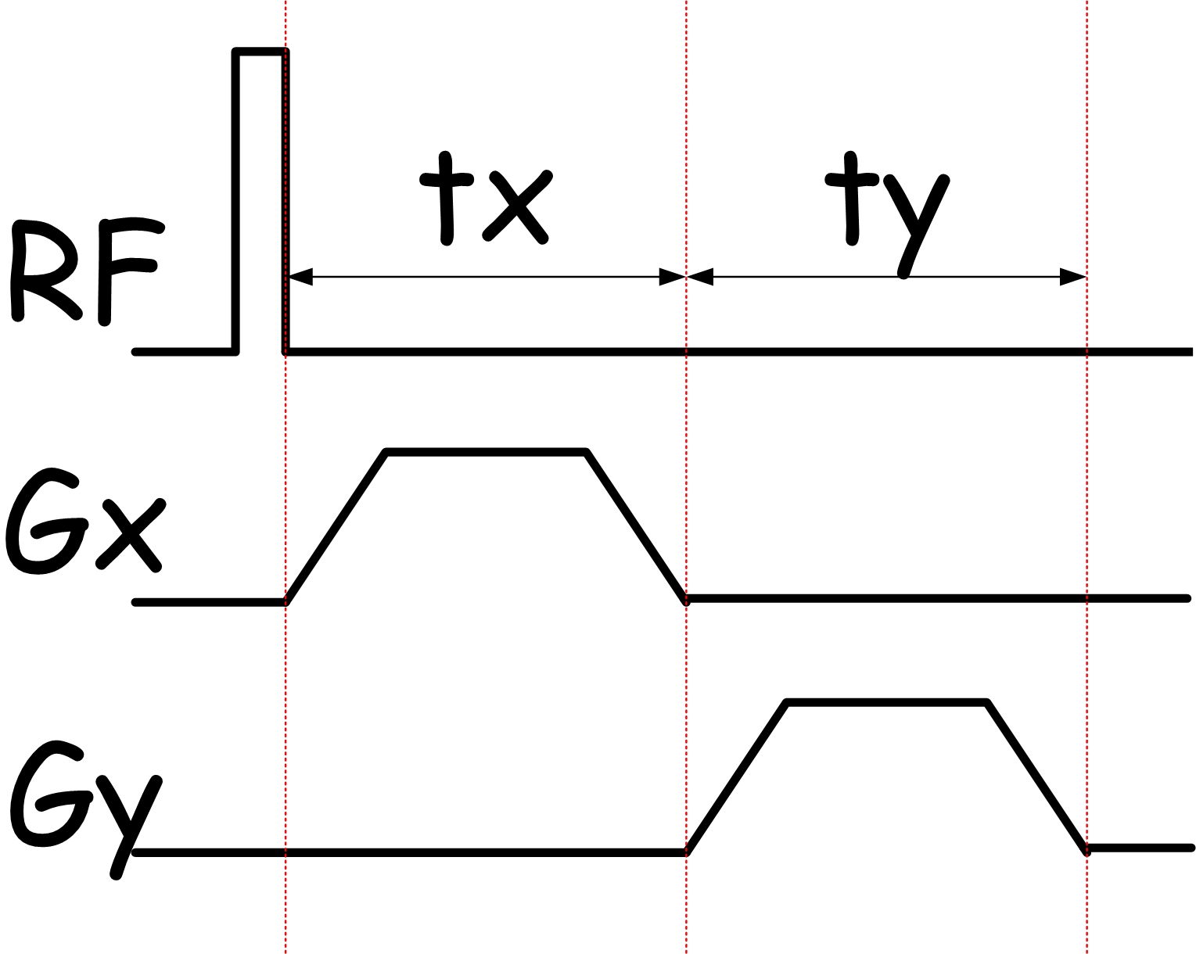
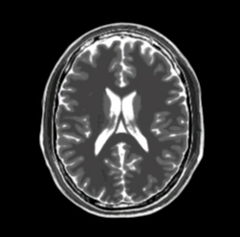
Image contrast in MRI can be achieved by acquiring data with different MRI pulse sequences, which act as filters, and counting spins (longitudinal or transverse direction) at each and every voxel.
MRI Pulse
Sequence
Spin
Image
MRI pulse sequence
Input
Filter
Output

Slide 30
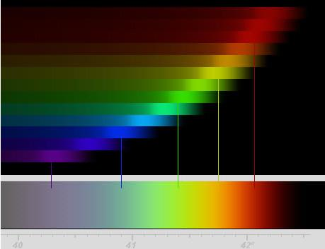
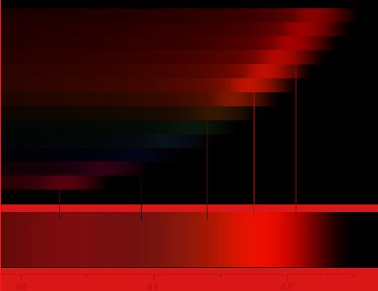
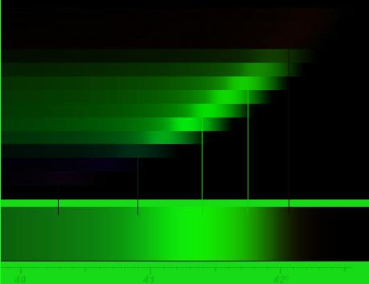

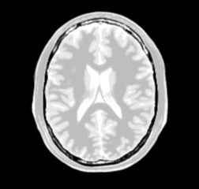
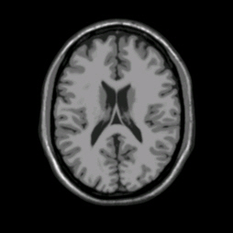
The MRI pulse sequence acts as a filter that selects the information that we are interested in measuring.
Tissue
Properties
Proton
Density
T2
Weighted
T1
Weighted
Pulse Sequence

Slide 31
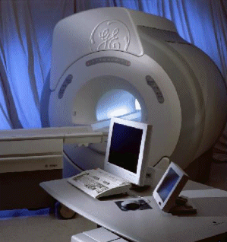
All imaging devices have three things in common
An energy source
An object which alters the energy source
A detector which measures the altered energy source intensity and position.

Slide 32
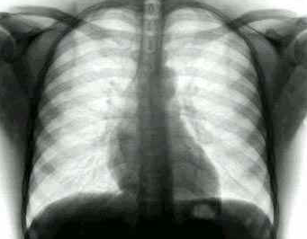
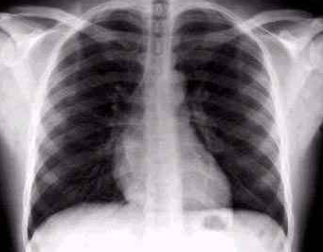
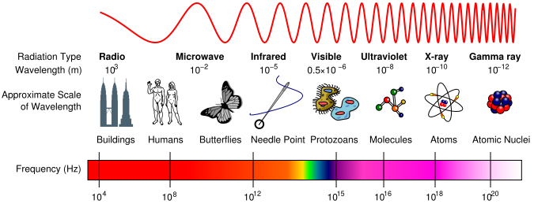
X-Ray scanners count the number of X-rays that pass through an object.
100
100
X-Ray Source
X-Ray Detector
100
10
Object
Notes:
1) http://science.howstuffworks.com/x-ray1.htm

Slide 33
MRI counts the number of energized spins at a particular location.
RF Source
MRI energy source is radio frequency (RF) waves
In a magnetic field, protons in the object that have spin absorb the energy from the radio waves
We detect the spins as they release the energy they just absorbed and return to thermal equilibrium.
The position of the spins in the object is determined by from it’s precession frequency.
Object
Object
RF Detector
Notes:
Tuning Fork Analogy

Slide 34
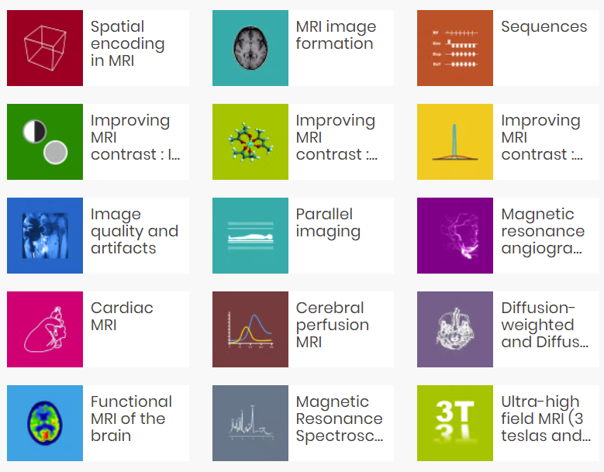
http://www.imaios.com/en/e-Courses/e-MRI

